Slide 1




Noida Institute of Engineering and Technology, Greater Noida
INTRODUCTION
Unit: 1
Artificial Intelligence(KCS071)
Renuka Sharma
CSE Department
B Tech 7th Sem

Slide 2
Brief Introduction About Me
Renuka Sharma
Designation: Assistant Professor CSE Department
NIET Greater Noida
Qualification:
B.Tech(CSE) from Ch. Devilal University ,Sirsa in 2013
M.tech(CSE) from AKTU Lucknow in 2017
Total Experience: 4
Research Publication:
particulars journals conferences
International 04 0
National 0 0

Slide 3
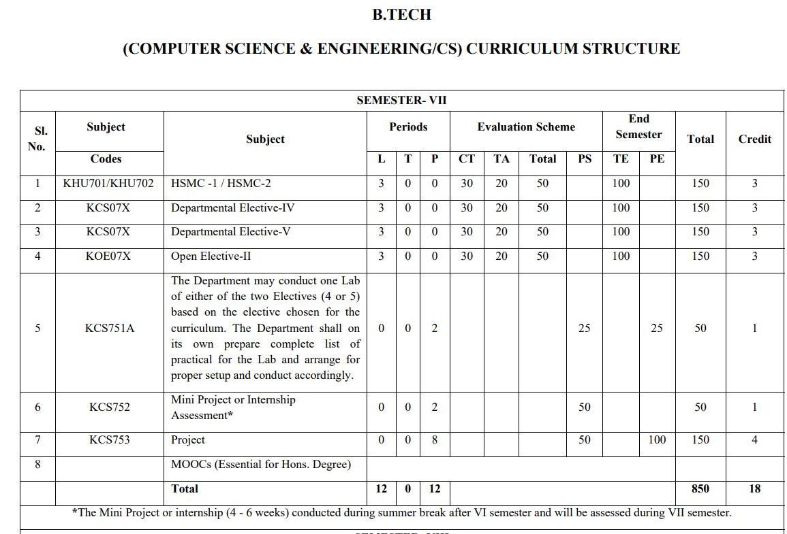
Evaluation Scheme

Slide 4
Branch wise Application
AI is the study of computer science that focuses on devising machines or developing software that exhibits human behaviour.
Examples of Artificial Intelligence / applications of AI : Medical, Banking, Security, Image/Video pattern detection, translation between languages.
AI Scope: Machine Learning and Deep Learning.

Slide 5
Content
Introduction to Artificial Intelligence
1.1 Why Artificial Intelligence?
1.2 Advantages/Disadvantages of AI
1.3 Goals of AI
1.4 Difference between Human & Machine Intelligence
1.5 AI Levels
1.6 Problems of AI
Foundations and History of Artificial Intelligence
Applications of Artificial Intelligence
Intelligent Agents
4.1 PEAS based grouping of Agents
Structure of Intelligent Agents
5.1 Types of Agents

Slide 6
Branch wise Application
AI is the study of computer science that focuses on devising machines or developing software that exhibits human behaviour.
Examples of Artificial Intelligence / applications of AI : Medical, Banking, Security, Image/Video pattern detection, translation between languages.
AI Scope: Machine Learning and Deep Learning.

Slide 7

Course Objectives
CO1 | To introduce the foundation & application of AI
CO2 | To have an understanding of basic issues of Blind and heuristic search
CO3 | An understanding of the main abstractions and reasoning techniques used in AI
CO4 | Understanding of machine learning
CO5 | Understanding pattern recognition

Slide 8
Course Outcome
COURSE | COURSE OUTCOME NO. | COURSE OUTCOMES At the end of the semester, the student will be able to:
KCS071 (Artificial Intelligence) | KCS071.1 | Understand the basics of the theory and practice of Artificial Intelligence as a discipline and about intelligent agents
 | KCS071.2 | Understand search techniques and gaming theory.
 | KCS071.3 | The student will learn to apply knowledge representation techniques and problem solving strategies to common AI applications.
 | KCS071.4 | Student should be aware of techniques used for classification and clustering.
 | KCS071.5 | Student should aware of basics of pattern recognition and steps required for it.

Slide 9
CO-PO and PSO Mapping
CO-PO correlation matrix
CO-PSO correlation matrix
 | PO1 | PO2 | PO3 | PO4 | PO5 | PO6 | PO7 | PO8 | PO9 | PO10 | PO11 | PO12
KCS071.1 | 3 | 2 | 2 | 2 | 2 | 1 | 1 | 2 | 1 | 1 | 2 | 2
KCS071.2 | 3 | 3 | 2 | 4 | 2 | 2 | 2 | 1 | 2 | 2 | 2 | 2
KCS071.3 | 2 | 2 | 3 | 2 | 3 | 2 | 1 | 2 | 2 | 2 | 2 | 2
KCS071.4 | 2 | 3 | 2 | 3 | 2 | 2 | 1 | 2 | 2 | 2 | 2 | 2
KCS071.5 | 2 | 2 | 2 | 2 | 2 | 2 | 2 | 1 | 2 | 2 | 1 | 3
 | PSO1 | PSO2 | PSO3 | PSO4
KCS071.1 | 3 | 2 | 2 | 2
KCS071.2 | 3 | 2 | 2 | 2
KCS071.3 | 3 | 2 | 3 | 2
KCS071.4 | 2 | 2 | 3 | 2
KCS071.5 | 2 | 1 | 1 | 1

Slide 10
Result Analysis
Artificial Intelligence | Course Outcomes
Department Wise | 98.3%
Subject Result | 98.46%
Faculty Result | 98.46%

Slide 11
Prerequisite and Recap
Fundamental knowledge of the field of Information Technology, along with being familiar with computers, the Internet, and basic working knowledge on data.
Good knowledge of Python, LISP.
Good foundation in calculus, linear algebra, statistics and discrete mathematics.

Slide 12
Objectives of Unit
To understand basic concept and evolution of Artificial Intelligence
To introduce the foundation of Artificial Intelligence
To explore applications of Artificial Intelligence
To understand application & structure of intelligent agents
To understand the concept of Natural Language processing

Slide 13
Topic Objective
Topic:
Introduction to Artificial Intelligence
Topic Objective:
To know what is Artificial Intelligence, what are the Goals of AI, what Problems exist, and Advantages/Disadvantages of AI

Slide 14
Prerequisites & Recap
Prerequisites:
Fundamental knowledge of the field of Information Technology, along with being familiar with computers, the Internet, and basic working knowledge on data.
Good knowledge of Python, LISP or PROLOG.
Good foundation in calculus, linear algebra, statistics and discrete mathematics.
Recap:
Review of Mathematics concepts
Review of Python programming

Slide 15
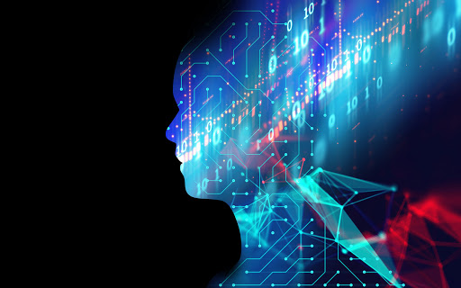
1. Introduction (CO1)
AI is the study of computer science that focuses on devising machines or developing software that exhibits human behavior.
Examples of these tasks are visual perception, speech recognition, decision-making, and translation between languages.
Purpose: to reduce human casualties in: Wars, Dangerous Workspaces, Car Accidents, Natural Disasters
to just make everyday life easier by helping with tasks such as: Cleaning, Shopping, Transportation

Slide 16
1.1 Why Artificial Intelligence?
With the help of AI, you can create such software or devices which can solve real-world problems very easily and with accuracy such as health issues, marketing, traffic issues, etc.
With the help of AI, you can create your personal virtual Assistant, such as Cortana, Google Assistant, Siri, etc.
With the help of AI, you can build such Robots which can work in an environment where survival of humans can be at risk.
AI opens a path for other new technologies, new devices, and new Opportunities.

Slide 17
1.2 Advantages of Artificial Intelligence
High Accuracy with less errors: AI machines or systems are prone to less errors and high accuracy as it takes decisions as per pre-experience or information.
High-Speed: AI systems can be of very high-speed and fast-decision making, because of that AI systems can beat a chess champion in the Chess game.
High reliability: AI machines are highly reliable and can perform the same action multiple times with high accuracy.
Useful for risky areas: AI machines can be helpful in situations such as defusing a bomb, exploring the ocean floor, where to employ a human can be risky.

Slide 18
Advantages of Artificial Intelligence
Digital Assistant: AI can be very useful to provide digital assistant to the users such as AI technology is currently used by various E-commerce websites to show the products as per customer requirement.
Useful as a public utility: AI can be very useful for public utilities such as a self-driving car which can make our journey safer and hassle-free, facial recognition for security purpose, Natural language processing to communicate with the human in human-language, etc.

Slide 19
Disadvantages of Artificial Intelligence
High Cost: The hardware and software requirement of AI is very costly as it requires lots of maintenance to meet current world reqts.
Can't think out of the box: Even we are making smarter machines with AI, but still they cannot work out of the box, as the robot will only do that work for which they are trained, or programmed.
No feelings and emotions: AI machines can be an outstanding performer, but still it does not have the feeling so it cannot make any kind of emotional attachment with human, and may sometime be harmful for users if the proper care is not taken.
Increase dependency on machines: With the increment of technology, people are getting more dependent on devices and hence they are losing their mental capabilities.
No Original Creativity: As humans are so creative and can imagine some new ideas but still AI machines cannot beat this power of human intelligence and cannot be creative and imaginative.

Slide 20
1.3 Goals of AI
Replicate human intelligence
Solve Knowledge-intensive tasks
An intelligent connection of perception and action
Building a machine which can perform tasks that requires human intelligence such as:
Proving a theorem
Playing chess
Plan some surgical operation
Driving a car in traffic
Creating some system which can exhibit intelligent behavior, learn new things by itself, demonstrate, explain, and can advise to its user.

Slide 21
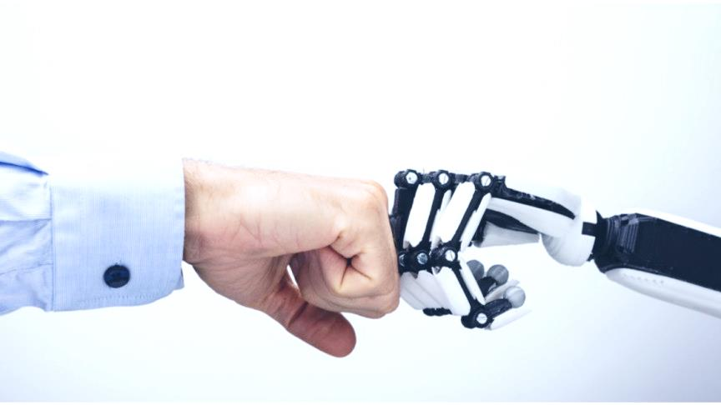
1.4 Difference between Human and Machine Intelligence
Humans perceive by patterns whereas the machines perceive by set of rules and data.
Humans store and recall information by patterns, machines do it by searching algorithms. For example, the number 40404040 is easy to remember, store, and recall as its pattern is simple.
Humans can figure out the complete object even if some part of it is missing or distorted; whereas the machines cannot do it correctly.

Slide 22
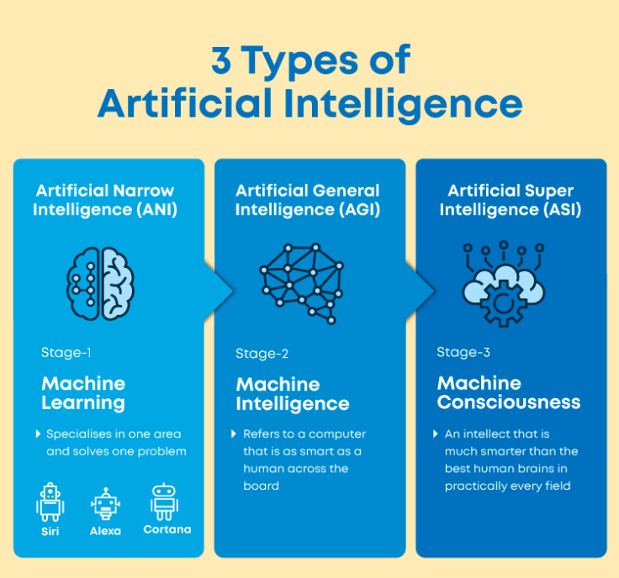
1.5 AI Levels
Narrow AI: A artificial intelligence is said to be narrow when the machine can perform a specific task better than a human. The current research of AI is here now
General AI: An artificial intelligence reaches the general state when it can perform any intellectual task with the same accuracy level as a human would
Strong AI: An AI is strong when it can beat humans in many tasks

Slide 23
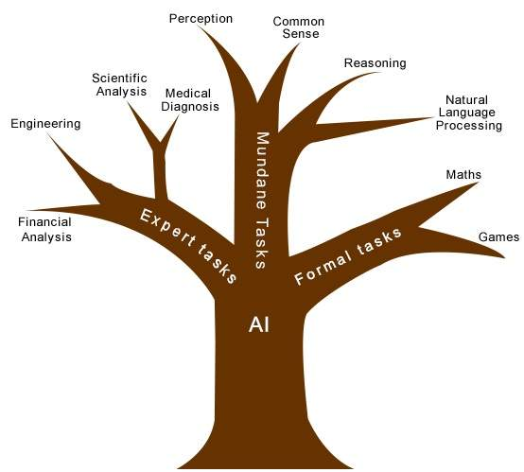
1.6 Task Domains of AI
Mundane Tasks
Planning
Vision
Robotics
natural language processing
Expert tasks
required specialized skills and training , for example Medical Diagnosis,Trouble Shooting Equipments.
Formal Tasks
Games
Mathematics

Slide 24
Topic objective
Topic:
Foundation & History of AI
Topic Objective:
To learn about the background of artificial intelligence, to know how it evolved throughout and what is currently in!

Slide 25
Prerequisites & Recap
Prerequisites:
Fundamental knowledge of the field of Information Technology, along with being familiar with computers, the Internet, and basic working knowledge on data.
Recap:
Studied the basics of Artificial Intelligence
Learned the goals, advantages/disadvantages, and levels of AI

Slide 26
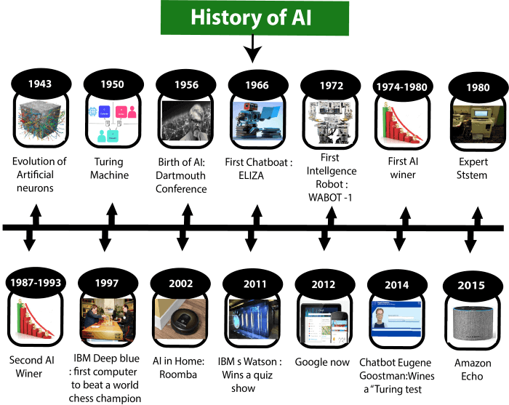
History of AI

Slide 27
Maturation of Artificial Intelligence (1943-1952)
Year 1943: The first work which is now recognized as AI was done by Warren McCulloch and Walter pits in 1943. They proposed a model of artificial neurons.
Year 1949: Donald Hebb demonstrated an updating rule for modifying the connection strength between neurons. His rule is now called Hebbian learning.
Year 1950: The Alan Turing who was an English mathematician and pioneered Machine learning in 1950. Alan Turing publishes "Computing Machinery and Intelligence" in which he proposed a test. The test can check the machine's ability to exhibit intelligent behavior equivalent to human intelligence, called a Turing test.

Slide 28
The birth of Artificial Intelligence (1952-1956)
Year 1955: An Allen Newell and Herbert A. Simon created the "first artificial intelligence program"Which was named as "Logic Theorist". This program had proved 38 of 52 Mathematics theorems, and find new and more elegant proofs for some theorems.
Year 1956: The word "Artificial Intelligence" first adopted by American Computer scientist John McCarthy at the Dartmouth Conference. For the first time, AI coined as an academic field.

Slide 29
The golden years-Early enthusiasm(1956-1974)
Year 1966: The researchers emphasized developing algorithms which can solve mathematical problems. Joseph Weizenbaum created the first chatbot in 1966, which was named as ELIZA.
Year 1972: The first intelligent humanoid robot was built in Japan which was named as WABOT-1.
The first AI winter (1974-1980)
The duration between years 1974 to 1980 was the first AI winter duration. AI winter refers to the time period where computer scientist dealt with a severe shortage of funding from government for AI researches.
During AI winters, an interest of publicity on artificial intelligence was decreased.

Slide 30
A boom of AI (1980-1987)
Year 1980: After AI winter duration, AI came back with "Expert System". Expert systems were programmed that emulate the decision-making ability of a human expert.
In the Year 1980, the first national conference of the American Association of Artificial Intelligence was held at Stanford University.
The second AI winter (1987-1993)
The duration between the years 1987 to 1993 was the second AI Winter duration.
Again Investors and government stopped in funding for AI research as due to high cost but not efficient result. The expert system such as XCON was very cost effective.

Slide 31
The emergence of intelligent agents (1993-2011)
Year 1997: In the year 1997, IBM Deep Blue beats world chess champion, Gary Kasparov, and became the first computer to beat a world chess champion.
Year 2002: for the first time, AI entered the home in the form of Roomba, a vacuum cleaner.
Year 2006: AI came in the Business world till the year 2006. Companies like Facebook, Twitter, and Netflix also started using AI.

Slide 32
Deep learning, big data and artificial general intelligence (2011-present)
Year 2011: In the year 2011, IBM's Watson won jeopardy, a quiz show, where it had to solve the complex questions as well as riddles. Watson had proved that it could understand natural language and can solve tricky questions quickly.
Year 2012: Google has launched an Android app feature "Google now", which was able to provide information to the user as a prediction.
Year 2014: In the year 2014, Chatbot "Eugene Goostman" won a competition in the infamous "Turing test."
Year 2018: The "Project Debater" from IBM debated on complex topics with two master debaters and also performed extremely well.

Slide 33
Topic Objective
Topic:
Applications of Artificial Intelligence
Topic Objective:
To learn about the areas where artificial intelligence has been proven to be useful and to develop an intellect to explore it further.

Slide 34
Prerequisites & Recap
Prerequisites:
Fundamental knowledge of the field of Information Technology, along with being familiar with computers, the Internet, and basic working knowledge on data.
Recap:
Studied the foundation & history of Artificial Intelligence and saw how it evolved throughout various stages.

Slide 35
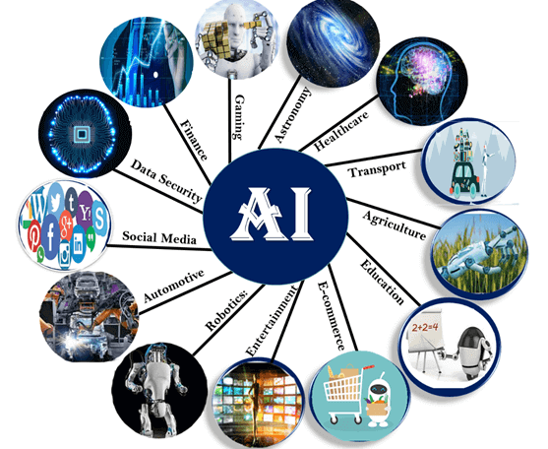
3. Applications of AI (CO1)
Game Playing
Speech Recognition
Computer Vision
Expert Systems
Virtual Reality
Image Processing
Artificial Creativity

Slide 36
Applications of AI
Gaming − AI plays crucial role in strategic games such as chess, poker, tic-tac-toe, etc., where machine can think of large number of possible positions based on heuristic knowledge.
Natural Language Processing − It is possible to interact with the computer that understands natural language spoken by humans.
Expert Systems − There are some applications which integrate machine, software, and special information to impart reasoning and advising. They provide explanation and advice to the users.
Vision Systems − These systems understand, interpret, and comprehend visual input on the computer. For example,
A spying aeroplane takes photographs, which are used to figure out spatial information or map of the areas.
Doctors use clinical expert system to diagnose the patient.
Police use computer software that can recognize the face of criminal with the stored portrait made by forensic artist.

Slide 37
Applications of AI
Speech Recognition − Some intelligent systems are capable of hearing and comprehending the language in terms of sentences and their meanings while a human talks to it. It can handle different accents, slang words, noise in the background, change in human’s noise due to cold, etc.
Handwriting Recognition − The handwriting recognition software reads the text written on paper by a pen or on screen by a stylus. It can recognize the shapes of the letters and convert it into editable text.
Intelligent Robots − Robots are able to perform the tasks given by a human. They have sensors to detect physical data from the real world such as light, heat, temperature, movement, sound, bump, and pressure. They have efficient processors, multiple sensors and huge memory, to exhibit intelligence. In addition, they are capable of learning from their mistakes and they can adapt to the new environment.

Slide 38
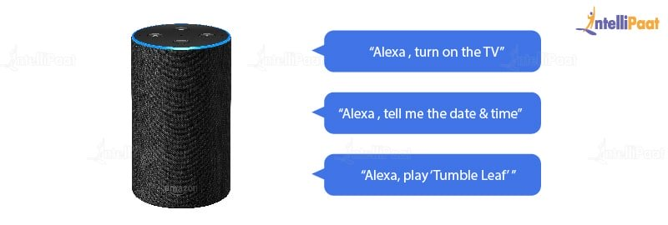
Amazon’s Alexa
Applications of AI
Alexa includes a speech recognition system that listens to our voice commands and gives answers. It recognizes our voice and then interprets it as a series of commands and returns the results to us. It uses AVS (Alexa Voice Service), which Amazon provides for free of cost.

Slide 39
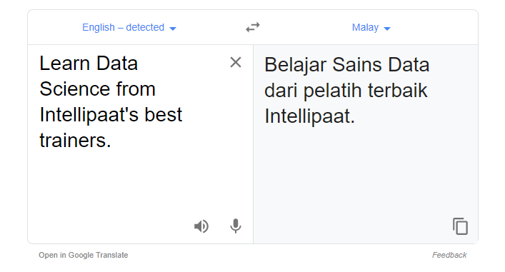
Google Translate
Applications of AI
Google Translate is another great application of Artificial Intelligence. It helps us translate sentences formed in one language to another. It can also translate the entire text on websites, which is possible only because of Artificial Intelligence.

Slide 40
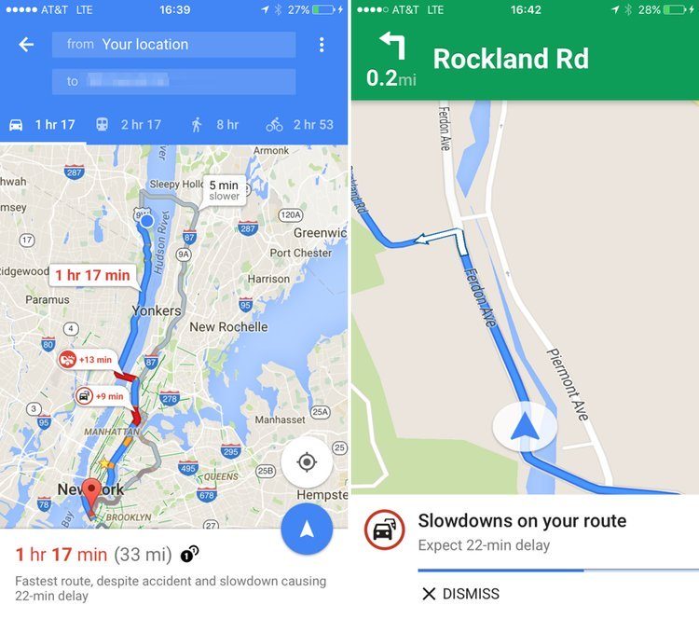
Google Maps
Applications of AI
Today, without Google Maps, it is impossible to survive in the city. With Google Maps, we can travel from one place to another without any difficulty. All we have to do is open Google Maps and enter our location. Then, its navigation will lead us with the most optimized path to our destination. This is also one of the wonderful applications of artificial intelligence.

Slide 41
Topic Objective
Topic:
Intelligent Agents
Topic Objective:
To understand PEAS based grouping of Agents. PEAS stands for Performance, Environment, Actuators, and Sensors

Slide 42
Prerequisites & Recap
Prerequisites:
Fundamental knowledge of the field of Information Technology, along with being familiar with computers, the Internet, and basic working knowledge on data.
Understanding of Python/LISP
Recap:
Studied the application areas of artificial intelligence

Slide 43
4. Intelligent Agents (CO1)
An agent is anything that can perceive its environment through sensors and acts upon that environment through effectors.
A human agent has sensory organs such as eyes, ears, nose, tongue and skin parallel to the sensors, and other organs such as hands, legs, mouth, for effectors.
A robotic agent replaces cameras and infrared range finders for the sensors, and various motors and actuators for effectors.
A software agent has encoded bit strings as its programs and actions.

Slide 44
4.1 PEAS based grouping of Agents
PEAS stands for Performance, Environment, Actuators, and Sensors. Based on these properties of an agent, they can be grouped together or can be differentiated from each other.
Performance: The output which we get from the agent. All the necessary results that an agent gives after processing comes under its performance.
Environment: All the surrounding things and conditions of an agent fall in this section. It basically consists of all the things under which the agents work.
Actuators: The devices, hardware or software through which the agent performs any actions or processes any information to produce a result are the actuators of the agent.
Sensors: The devices through which the agent observes and perceives its environment are the sensors of the agent.

Slide 45
PEAS based grouping of Agents- Example
EXAMPLE: Let us take an example of a self-driven car. As the name suggests, it is a car which drives on its own, by taking all the necessary decisions while driving without any help from the user (customer). In other words, we can say that this car drives on its own and requires no driver.
The PEAS description for this agent will be as follows:
Performance: The performance factors for a self-driven car will be the Speed, Safety while driving (both of the car and the user), Time is taken to drive to a particular location, the comfort of the user, etc.
Environment: The road on which the Car is being driven, other cars present on the road, crossings, road signs, traffic signals, etc. , all act as its environment.

Slide 46
PEAS based grouping of Agents- Example
Actuators: All those devices through which the control of the car is handled, are the actuators of the car. For example, the Steering, Accelerator, Breaks, Horn, Music system, etc.
Sensors: All those devices through which the car gets an estimate about its surroundings and it can draw certain perceptions out of it are its sensors. For example, Camera, Speedometer, GPS, Odometer, Sonar, etc.

Slide 47
Topic Objective
Topic:
Structure of Intelligent Agents
Topic Objective:
To learn about architecture and agent program and to study different Types of Agents and their working

Slide 48
Prerequisites & Recap
Prerequisites:
Fundamental knowledge of the field of Information Technology, along with being familiar with computers, the Internet, and basic working knowledge on data.
Understanding of Python/LISP
Recap:
Studied what is an agent program and the PEAS based grouping of Agents.

Slide 49

5. Structure of Intelligent Agents(CO1)
Agent’s structure can be viewed as −
Agent = Architecture + Agent Program
Architecture = the machinery that an agent executes on. It is a device with sensors and actuators, for example : a robotic car, a camera, a PC.
Agent Program = an implementation of an agent function.
An agent function is a map from the percept sequence(history of all that an agent has perceived till date) to an action.

Slide 50

Structure of Intelligent Agents
A simple agent program can be defined mathematically as a function f (called the "agent function")which maps every possible percepts sequence to a possible action the agent can perform or to a coefficient, feedback element, function or constant that affects eventual actions:
f:P* --> A
Agent function is an abstract concept as it could incorporate various principles of decision making like calculation of utility of individual options, deduction over logic rules, fuzzy logic, etc.
The program agent, instead, maps every possible percept to an action.
We use the term percept to refer to the agent's perceptional inputs at any given instant.

Slide 51
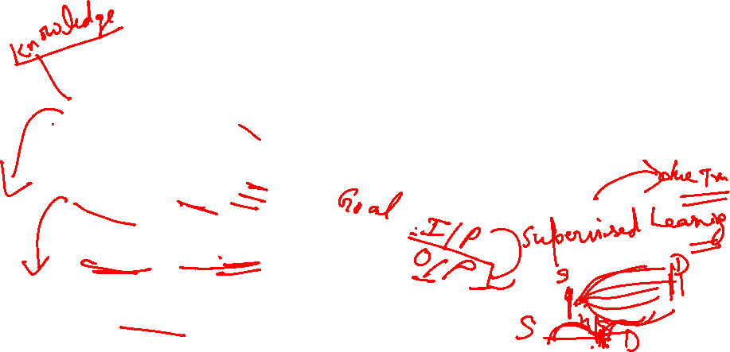
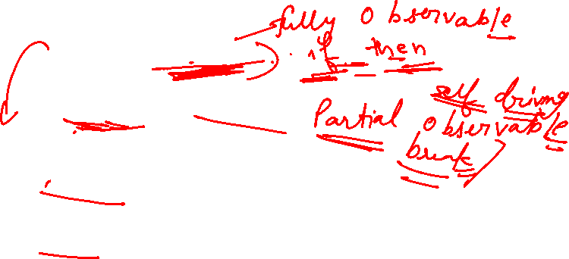
5.1 Types of Intelligent Agents
Types of AI Agents
Simple Reflex Agent
Model-based reflex agent
Goal-based agents
Utility-based agent
Learning agent

Slide 52
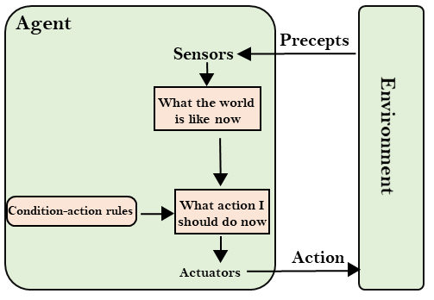
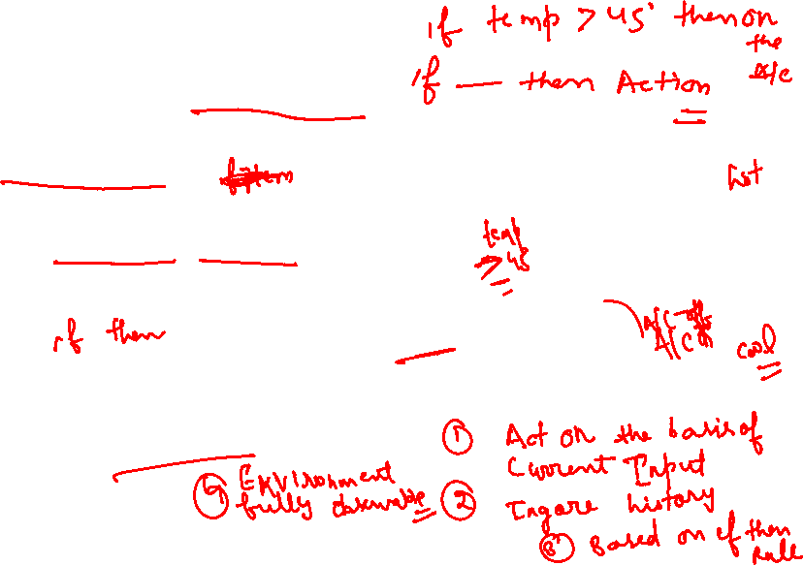
Types of Agents
Simple Reflex agent:
These agents take decisions on the basis of the current percepts and ignore the rest of the percept history.
These agents only succeed in the fully observable environment.
The Simple reflex agent works on Condition-action rule, which means it maps the current state to action. Such as a Room Cleaner agent, it works only if there is dirt in the room.

Slide 53
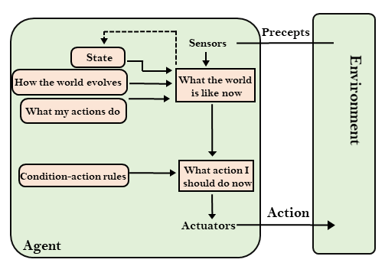
Types of Agents
Model-based reflex agent:
The Model-based agent can work in a partially observable environment, and track the situation.
These agents have the model, "which is knowledge of the world" and based on the model they perform actions.
Updating the agent state requires information about: How the world evolves & How the agent's action affects the world.

Slide 54
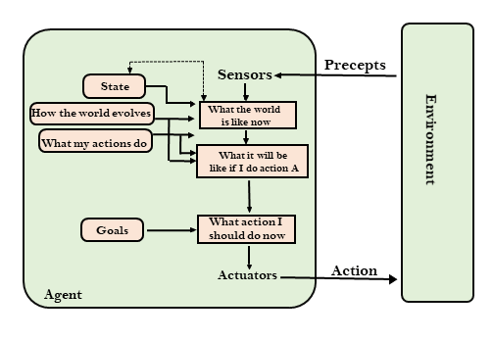
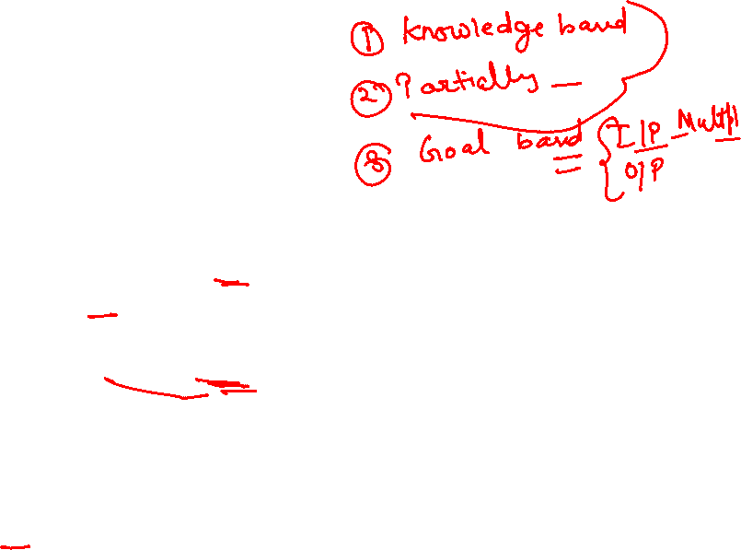
Types of Agents
Goal-based agents:
The knowledge of the current state environment is not always sufficient to decide for an agent to what to do.
Goal-based agents expand the capabilities of the model-based agent by having the "goal" information.
They choose an action, so that they can achieve the goal.
These agents may have to consider a long sequence of possible actions before deciding whether the goal is achieved or not.

Slide 55
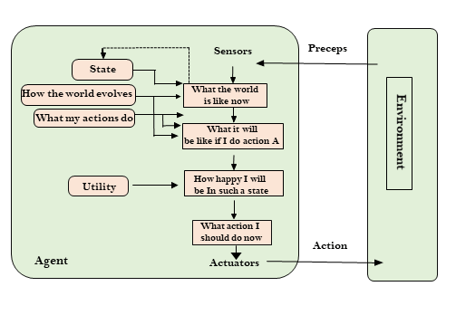
Types of Agents
Utility-based agents:
These agents are similar to the goal-based agent but provide an extra component of utility measurement which makes them different by providing a measure of success at a given state.
The Utility-based agent is useful when there are multiple possible alternatives, and an agent has to choose in order to perform the best action.
The utility function maps each state to a real number to check how efficiently each action achieves the goals.

Slide 56
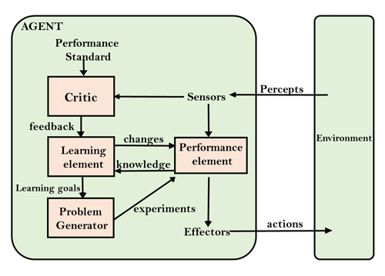
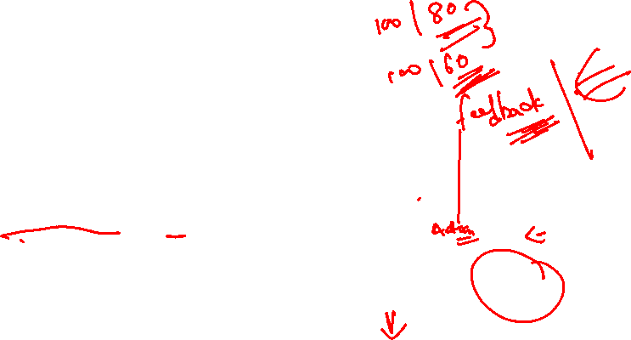
Types of Agents
Learning Agents:
A learning agent in AI is the type of agent which can learn from its past experiences, or it has learning capabilities.
It starts to act with basic knowledge and then able to act and adapt automatically through learning.
A learning agent has mainly four conceptual components, which are: Learning element, Critic, Performance element, Problem generator.

Slide 57
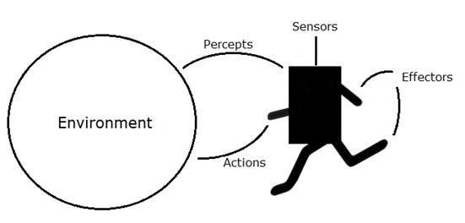
Intelligent agents
Performance Measure of Agent − It is the criteria, which determines how successful an agent is.
Behavior of Agent − It is the action that agent performs after any given sequence of percepts.

Slide 58
Intelligent agents
Percept − It is agent’s perceptual inputs at a given instance.
Percept Sequence − It is the history of all that an agent has perceived till date.
Agent Function − It is a map from the precept sequence to an action.

Slide 59
Faculty Video Links, Youtube & NPTEL Video Links and Online Courses Details
Youtube/other Video Links:
https://www.youtube.com/watch?v=pAMGj0AT5Wk
https://www.youtube.com/watch?v=XCPZBD9lbVo
https://nptel.ac.in/courses/106105077/

Slide 60
Daily Quiz
Who is the “father” of artificial intelligence? a) Fisher Ada b) John McCarthy c) Allen Newell d) Alan Turning
In 1985, the famous chess player David Levy beat a world champion chess program in four straight games by using orthodox moves that confused the program. What was the name of the chess program? a) Kaissa b) CRAY BLITZ c) Golf d) DIGDUG

Slide 61
Daily Quiz
The conference that launched the AI revolution in 1956 was held at? a) Dartmouth b) Harvard c) New York d) Stanford
The Al researcher who co-authored both the Handbook of Artificial Intelligence and The Fifth Generation is __________ a) Bruce Lee b) Randy Davis c) Ed Feigenbaum d) Mark Fox

Slide 62
Daily Quiz
The Face Recognition system is based on? a) Strong Artificial Intelligence approach b) Weak Artificial Intelligence approach c) Cognitive Artificial Intelligence approach d) Applied Artificial Intelligence approach
A completely automated chess engine (Learn from previous games) is based on? a) Strong Artificial Intelligence approach b) Weak Artificial Intelligence approach c) Cognitive Artificial Intelligence approach d) Applied Artificial Intelligence approach

Slide 63
Daily Quiz
How many types of agents are there in artificial intelligence? a) 1 b) 2 c) 3 d) 4
What are the composition for agents in artificial intelligence? a) Program b) Architecture c) Both Program & Architecture d) None of the mentioned

Slide 64
Daily Quiz
In which agent does the problem generator is present? a) Learning agent b) Observing agent c) Reflex agent d) None of the mentioned
Which is used to improve the agents performance? a) Perceiving b) Learning c) Observing d) None of the mentioned

Slide 65
Daily Quiz
Which element in the agent are used for selecting external actions? a) Perceive b) Performance c) Learning d) Actuator
NLP is concerned with the interactions between computers and human (natural) languages. a) True b) False

Slide 66
Daily Quiz
What is Coreference Resolution? a) Anaphora Resolution b) Given a sentence or larger chunk of text, determine which words (“mentions”) refer to the same objects (“entities”) c) All of the mentioned d) None of the mentioned
Modern NLP algorithms are based on machine learning, especially statistical machine learning. a) True b) False
What is Morphological Segmentation? a) Does Discourse Analysis b) Separate words into individual morphemes and identify the class of the morphemes c) Is an extension of propositional logic d) None of the mentioned

Slide 67
Weekly Assignment
What are the various areas where AI (Artificial Intelligence) can be used?
What Are Intelligent Agents, and How Are They Used in AI?
What are the Problem Characteristics of Artificial Intelligence?
Design the PEAS measure for satellite agent
Describe the role of computer vision in artificial intelligence. Write the history of AI
What are the factors that a rational agent should depend on at any given time?
State the various properties of an environment
What are the goals of AI?

Slide 68
MCQ s
What is Artificial intelligence? a) Putting your intelligence into Computer b) Programming with your own intelligence c) Making a Machine intelligent d) Playing a Game
Strong Artificial Intelligence is __________ a) the embodiment of human intellectual capabilities within a computer b) a set of computer programs that produce output that would be considered to reflect intelligence if it were generated by humans c) the study of mental faculties through the use of mental models implemented on a computer d) all of the mentioned

Slide 69
MCQ s
Visual clues that are helpful in computer vision include __________ a) color and motion b) depth and texture c) height and weight d) color and motion, depth and texture
The performance of an agent can be improved by __________ a) Learning b) Observing c) Perceiving d) None of the mentioned

Slide 70
MCQ s
External actions of the agent is selected by __________ a) Perceive b) Performance c) Learning d) Actuator
A computer vision technique that relies on image templates is __________ a) edge detection b) binocular vision c) model-based vision d) robot vision

Slide 71
MCQ s
The action of the Simple reflex agent completely depends upon __________ a) Perception history b) Current perception c) Learning theory d) Utility functions
A basic line following robot is based on __________ a) Strong Artificial Intelligence approach b) Weak Artificial Intelligence approach c) Cognitive Artificial Intelligence approach d) Applied Artificial Intelligence approach

Slide 72
MCQ s
Which of the following task/tasks Artificial Intelligence could not do yet? a) Understand natural language robustly b) Web mining c) Construction of plans in real time dynamic systems d) All of the mentioned
Which instruments are used for perceiving and acting upon the environment? a) Sensors and Actuators b) Sensors c) Perceiver d) None of the mentioned

Slide 73
MCQ s
What is meant by agent’s percept sequence? a) Used to perceive the environment b) Complete history of actuator c) Complete history of perceived things d) None of the mentioned
What is the rule of simple reflex agent? a) Simple-action rule b) Condition-action rule c) Simple & Condition-action rule d) None of the mentioned
Which agent deals with happy and unhappy states? a) Simple reflex agent b) Model based agent c) Learning agent d) Utility based agent

Slide 74
MCQ s
Which kind of agent architecture should an agent an use? a) Relaxed b) Logic c) Relational d) All of the mentioned
What is the main challenge/s of NLP? a) Handling Ambiguity of Sentences b) Handling Tokenization c) Handling POS-Tagging d) All of the mentioned

Slide 75
MCQ s
Choose form the following areas where NLP can be useful. a) Automatic Text Summarization b) Automatic Question-Answering Systems c) Information Retrieval d) All of the mentioned
Which of the following includes major tasks of NLP? a) Automatic Summarization b) Discourse Analysis c) Machine Translation d) All of the mentioned

Slide 76
MCQ s
What is the field of Natural Language Processing (NLP)? a) Computer Science b) Artificial Intelligence c) Linguistics d) All of the mentioned
Modern NLP algorithms are based on machine learning, especially statistical machine learning. a) True b) False
What is Machine Translation? a) Converts one human language to another b) Converts human language to machine language c) Converts any human language to English d) Converts Machine language to human language

Slide 77
Glossary Questions
[Converts one human language to another , Handling Ambiguity of Sentences ,Computer Science, Sensors and Actuators, Current perception]
Field of Natural Language Processing (NLP).
Machine Translation is _______________.
Main challenge/s of NLP_____________.
The action of the Simple reflex agent completely depends upon_____.
Which instruments are used for perceiving and acting upon the environment?

Slide 78
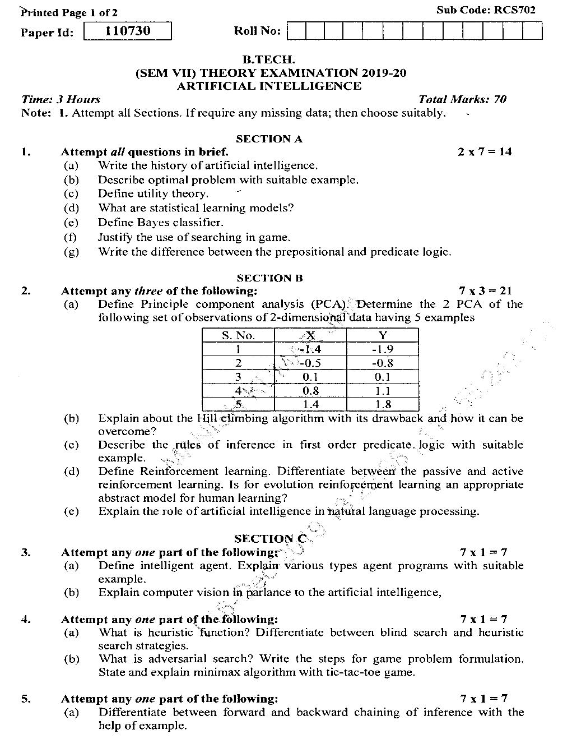
Old Question Paper

Slide 79
Old Question Paper

Slide 80
Old Question Papers

Slide 81
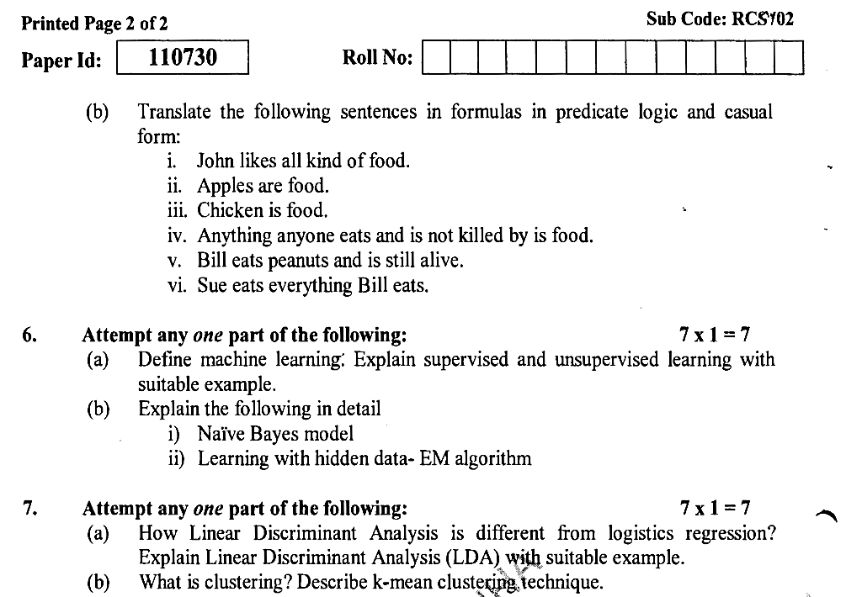
Old Question Papers
Note: The Subject with this code was introduced last year only; so only one previous year paper available

Slide 82
Expected Questions for University Exam
Give the structure of an agent in an environment
How to measure the performance of an agent?
What are the factors that a rational agent should depend on at any given time?
How is computer vision related to AI?
Give applications of NLP
Write the history of Artificial Intelligence
Define learning agent with the help of architecture.
What is PEAS? Explain with example
What is the role of NLP in AI? Define various phases of NLP
List various criterions for success in AI

Slide 83
Summary
Google has demonstrated an AI program "Duplex" which was a virtual assistant and which had taken hairdresser appointment on call, and lady on other side didn't notice that she was talking with the machine.
The concept of Deep learning, big data, and data science are now trending like a boom. Nowadays companies like Google, Facebook, IBM, and Amazon are working with AI and creating amazing devices.

Slide 84
References
Text books:
Stuart Russell, Peter Norvig, “Artificial Intelligence – A Modern Approach”, Pearson Education
Dan W. Patterson, “Artificial Intelligence and Expert Systems”, Prentice Hall of India,
Web:
https://www.tutorialspoint.com/artificial_intelligence/index.htm
https://www.javatpoint.com/artificial-intelligence-tutorial
https://becominghuman.ai/a-simple-introduction-to-natural-language-processing-ea66a1747b32
https://intellipaat.com/blog/tutorial/artificial-intelligence-tutorial/
https://www.guru99.com/artificial-intelligence-tutorial.html

Slide 85
Thank You

